Slide 1

Dr. Ammar Haider
Assistant Professor
School of Computing
CS3002 Information Security
Modern Symmetric Ciphers
Source: Stallings CNS chap 4, 6

Slide 2
Modern Ciphers
“A modern block cipher can be designed to act as a substitution cipher or a transposition cipher. This is the same idea as is used in traditional ciphers, except that the symbols to be substituted or transposed are bits instead of characters.”
Forouzan, Cryptography & Network Security

Slide 3
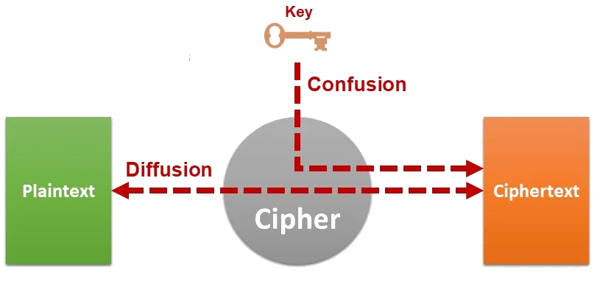
Strength of a cipher
A cipher needs to completely obscure statistical properties of original message
In 1945, Shannon suggested that a cipher needs to have these two properties:

Slide 4
Confusion
Confusion means that each character (e.g. bit) of the ciphertext should depend on several parts of the key, obscuring the connection between the two.
This property makes it difficult to find key from ciphertext. If a single bit in key is changed, calculation of values of most or all bits in ciphertext will be affected.
In classical ciphers, substitution provides confusion

Slide 5
Diffusion
Diffusion means the influence of one plaintext symbol is spread over many ciphertext symbols, so that statistical properties of plaintext remain hidden.
In classical ciphers, permutation provides diffusion
Ciphers that only perform confusion or only diffusion are not secure enough.
Except for one-time pad, which is confusion only; but as discussed, it is impractical.
A product cipher is the one which includes both of these operations.

Slide 6
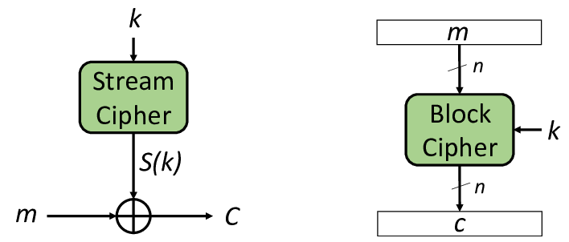
Block & Stream ciphers
Block ciphers break messages into blocks of predetermined sizes – e.g. 64 bits or 128 bits.
Cipher encrypts one block of plaintext, creating a ciphertext block of same size.
Each character (e.g. bit) contributes to encryption of other characters in the block
https://ieeexplore.ieee.org/document/9093670/

Slide 7
Block & Stream ciphers
In stream ciphers, encryption is done on much smaller unit (bit, byte etc.)
Units in plaintext are fed into encryption algorithm as a stream (one at a time), ciphertext is similarly outputted as a stream.
They are more suitable when data is a continuous stream
Stream ciphers do not provide diffusion, since there is a one-to-one mapping between units in plaintext and ciphertext.
https://ieeexplore.ieee.org/document/9093670/

Slide 8
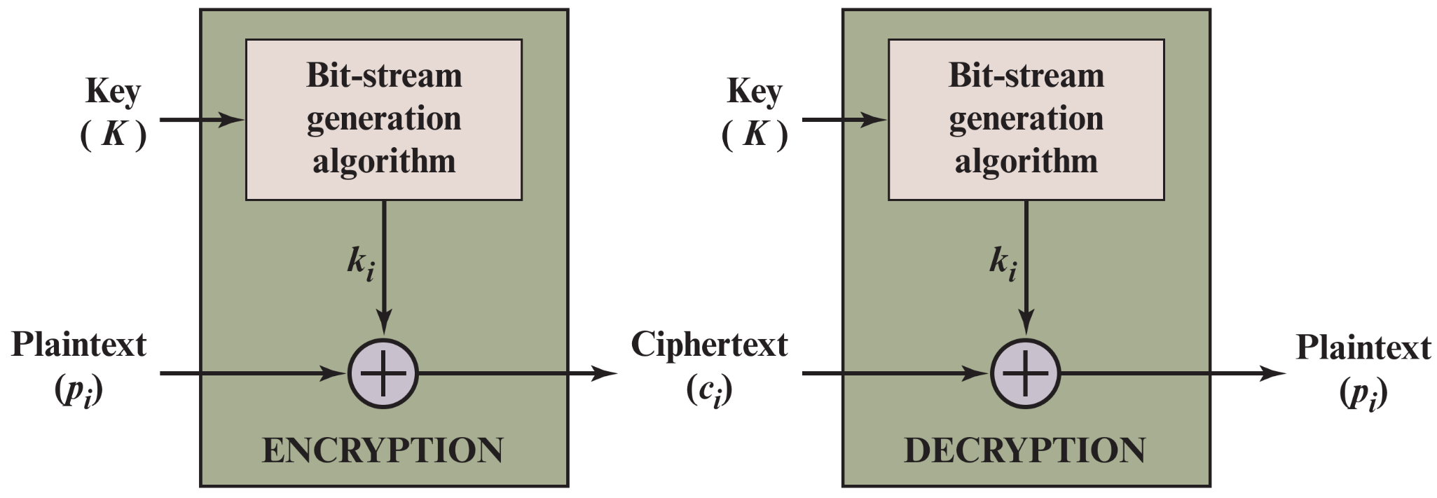
Block & Stream ciphers
Stream ciphers high level structure
Bitwise XOR

Slide 9
XOR operation: extremely useful in crypto
XOR
AND
OR
0 | 0 | 0
0 | 1 | 1
1 | 0 | 1
1 | 1 | 0
0 | 0 | 0
0 | 1 | 0
1 | 0 | 0
1 | 1 | 1
0 | 0 | 0
0 | 1 | 1
1 | 0 | 1
1 | 1 | 1
Information Leak!
Primary reason: It does not reveal any information about plaintext (both 0 and 1 are equally likely).
Secondary advantage: Both encryption and decryption can be done the same way, by adding the key. XOR is a self-inverse function!
010010 ⊕ 101100 = 111110
plaintext key ciphertext
111110 ⊕ 101100 = 010010
ciphertext key plaintext

Slide 10
Modern Encryption Algorithms
Examples
Block Ciphers
DES
3DES
AES
Twofish
Stream Ciphers
RC4
ChaCha20

Slide 11
Data Encryption Standard
DES was once the most widely used encryption scheme
developed in early 1970s at IBM, slightly tweaked by NSA
the first modern, public, freely available encryption algorithm
Standardized by National Bureau of Standards in 1977
Uses 64 bit plaintext block and 56 bit key to produce a 64 bit cipher text block

Slide 12
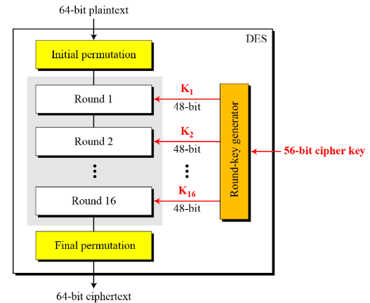
DES Algorithm

Slide 13
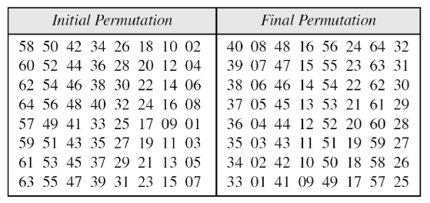
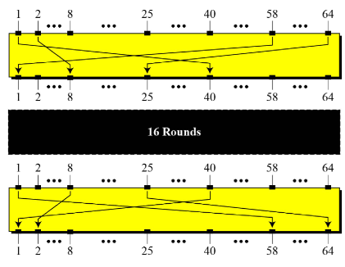
DES Algorithm
Initial and final permutation
(inverse of each other)

Slide 14
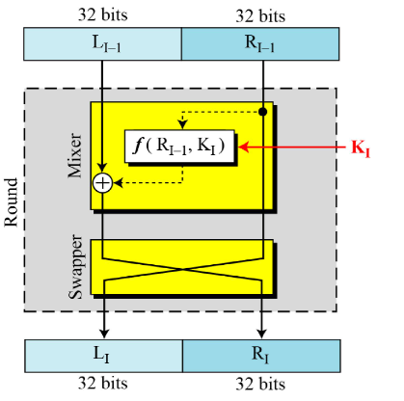
DES Round
One round in DES (Feistel structure)
f(…) is the DES function

Slide 15
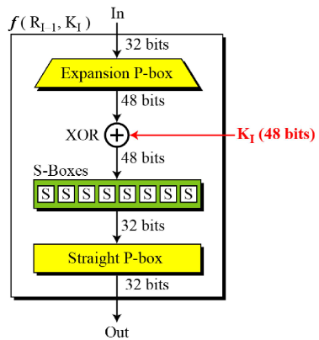
DES Function

Slide 16
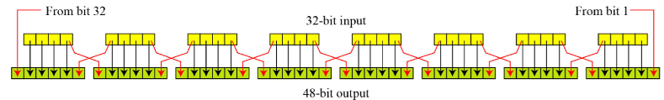
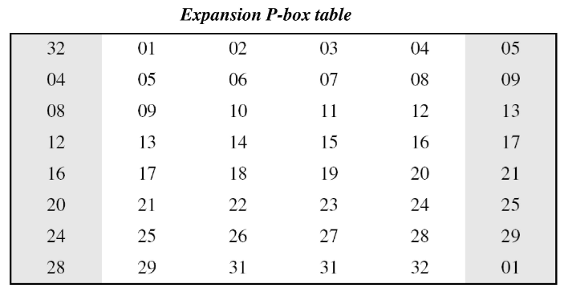
DES Function: Expansion
Expansion Mechanism

Slide 17
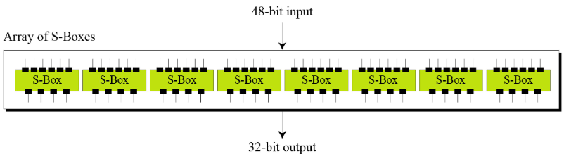
DES Function: S-Boxes
All 8 S-Boxes have same working principle, but different substitution tables

Slide 18
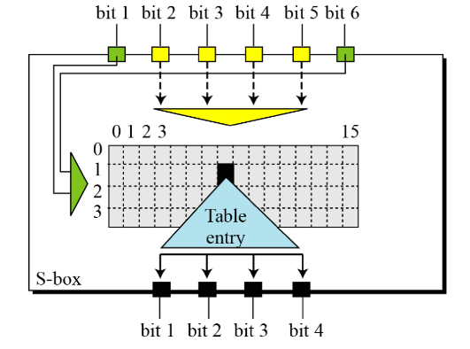
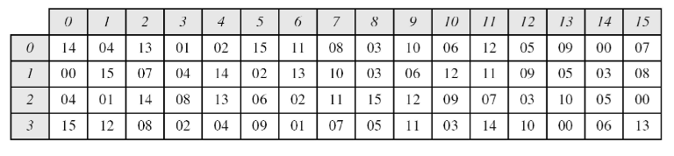
DES Function: S-Box-1
Example: If input is 101100₂
We check row 2 (10₂) and column 6 (0110₂) to get output 2, which is 0010₂
Find the output if S-Box-1 input is 100011

Slide 19
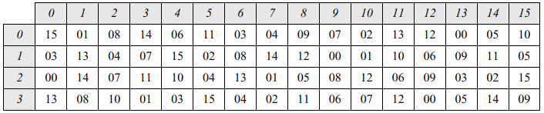
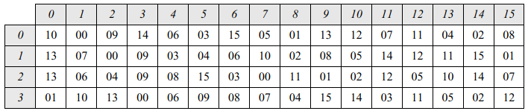
DES Function: S-Boxes
S-Box-2
S-Box-3

Slide 20
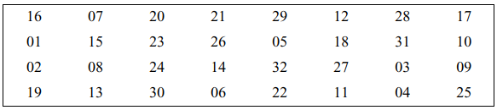
DES Function: Straight P-Box
32-bit input to 32-bit output
16th bit of input becomes 1st bit of output, and so on.

Slide 21
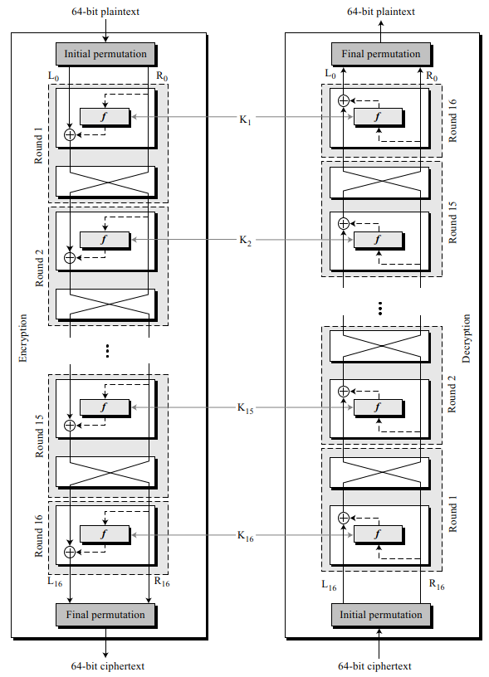
DES Decryption
During encryption, skip the swapper in the last round.
For decryption, go through the same procedure as encryption (i.e. initial permutation, 16 rounds, final permutation), just use the round keys in reverse order
this methodology is common in all Fiestel ciphers

Slide 22
DES Strength Analysis
DES is probably the most-scrutinized encryption algorithm, and to date no substantial mathematical weakness has been discovered.
BUT… it is not resistant to brute force attacks.

Slide 23
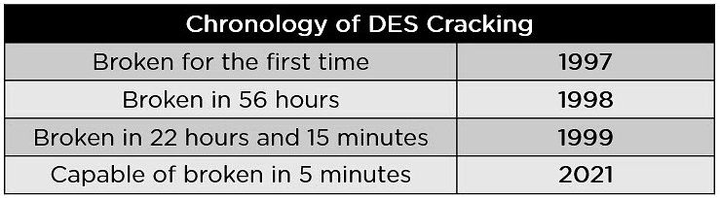
DES Strength Analysis
Short key length
With 56 bits, there are 2⁵⁶ possible keys, which is approximately 7.2 × 10¹⁶ keys, which can be broken in relatively short time by brute forcing.
More powerful and parallelized hardware yields quicker results
Within 26 hours when using a specialized hardware: https://crack.sh

Slide 24
Triple DES (3DES)
Repeats basic DES algorithm three times
Using either two or three unique keys
key size of 112 or 168 bits.
much more secure but also much slower
plaintext
DES
encrypt
DES
decrypt
DES
encrypt
ciphertext
K1
K2
K1
With two keys, Effective key length = 112 bits

Slide 25
Triple DES (3DES)
Repeats basic DES algorithm three times
Using either two or three unique keys
key size of 112 or 168 bits.
much more secure but also much slower
plaintext
DES
encrypt
DES
decrypt
DES
encrypt
ciphertext
K1
K2
K3
With three keys, Effective key length = 168 bits

Slide 26
Advanced Encryption Standard
NIST called for proposals in 1997
goals: efficiency, security, HW/SW suitability
key length 128, 192, 256 bits
Selected Rijndael in Nov 2001 and declared as ‘AES’
Symmetric block cipher
Uses 128 bit data block & 128/192/256 bit keys
Now widely available commercially

Slide 27
The AES Cipher - Rijndael
An iterative rather than Feistel cipher
processes data as block of 4 columns of 4 bytes (128 bits)
operates on entire data block in every round
Plaintext (128 bits)
AES
Key (128/192/256 bits)
Ciphertext (128 bits)
Notes:
The Rijndael proposal for AES defined a cipher in which the block length and the key length can be independently specified to be 128,192,or 256 bits. The AES specification uses the same three key size alternatives but limits the block length to 128 bits. Rijndael is an academic submission, based on the earlier Square cipher, from Belgium academics Dr Joan Daemen and Dr Vincent Rijmen. It is an iterative cipher (operates on entire data block in every round) rather than feistel (operate on halves at a time), and was designed to have characteristics of: Resistance against all known attacks, Speed and code compactness on a wide range of platforms, & Design simplicity.

Slide 28
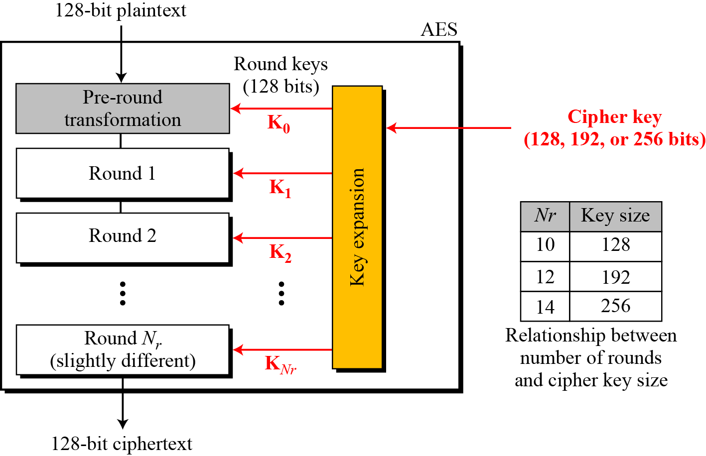
Multiple rounds
Notes:
The input to the AES encryption and decryption algorithms is a single 128-bit block, depicted in FIPS PUB 197, as a square matrix of bytes .This block is copied into the State array, which is modified at each stage of encryption or decryption. After the final stage, State is copied to an output.
The key is expanded into 44/52/60 lots of 32-bit words (see later), with 4 used in each round.
The data computation then consists of an “add round key” step, then 9/11/13 rounds with all 4 steps, and a final 10th/12th/14th step of byte subs + mix cols + add round key. This can be viewed as alternating XOR key & scramble data bytes operations. All of the steps are easily reversed, and can be efficiently implemented using XOR’s & table lookups.

Slide 29
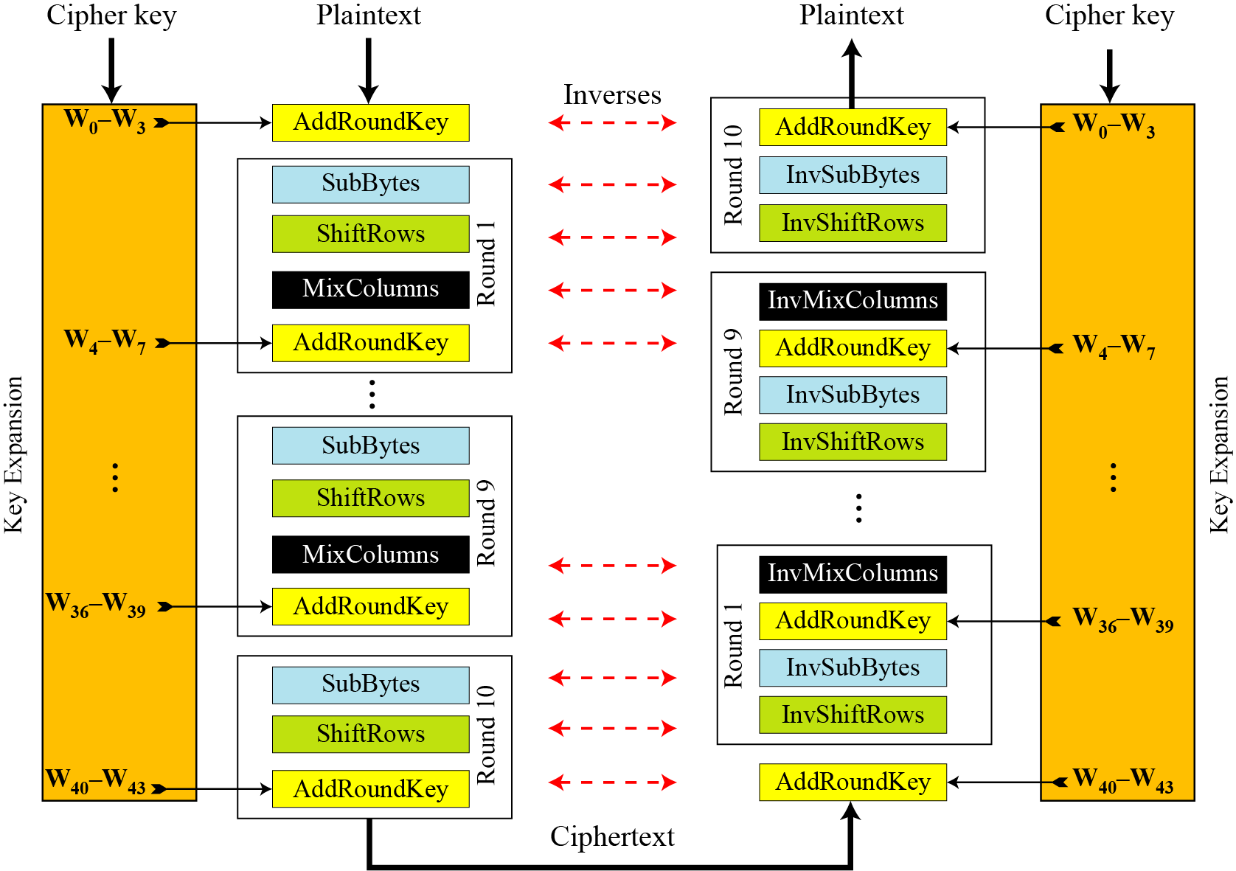
Overall Structure
Notes:
Stallings Figure 5.1 shows the overall structure of AES, as detailed on the previous slide.

Slide 30
Structure of 128-bit block
Data block viewed as table of bytes
Represented as 4 by 4 matrix of bytes.
Key is expanded to array of 32 bits words
1 byte

Slide 31
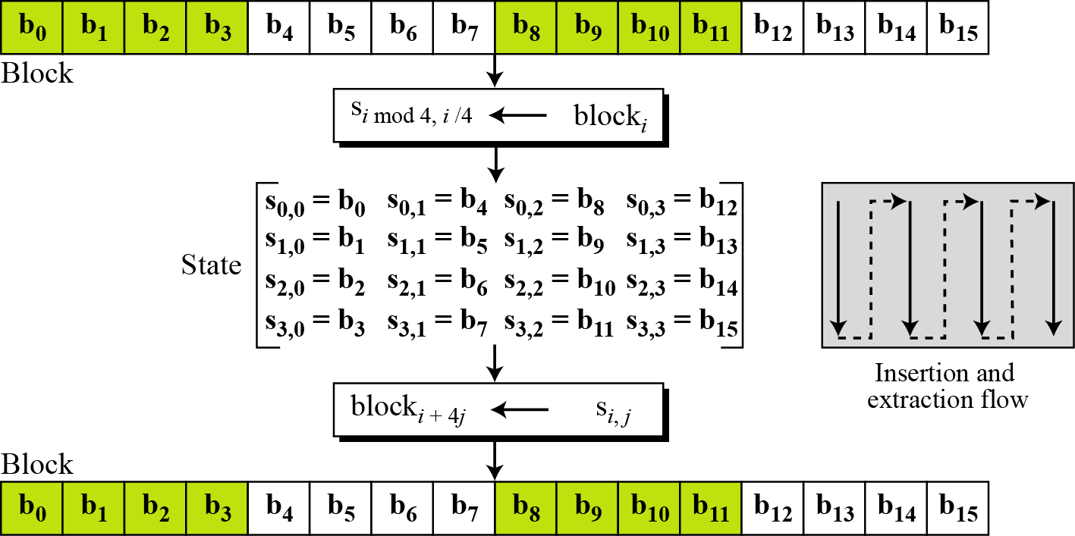
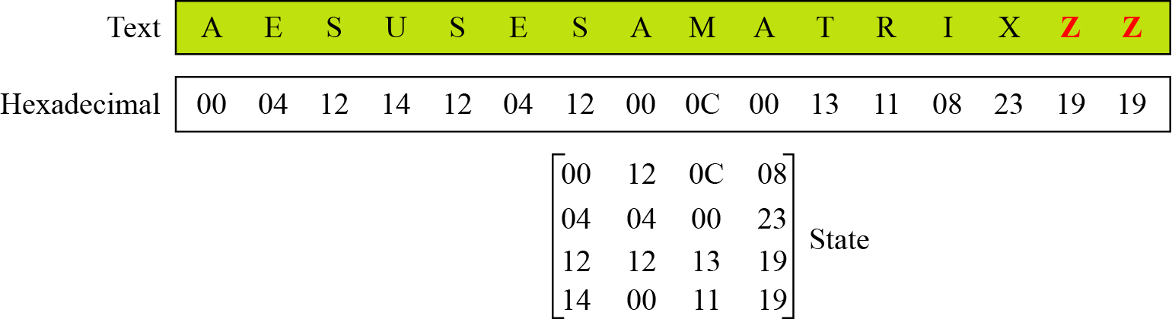
Data block represented as ‘State’
(bytes)
Example - changing plaintext to State

Slide 32
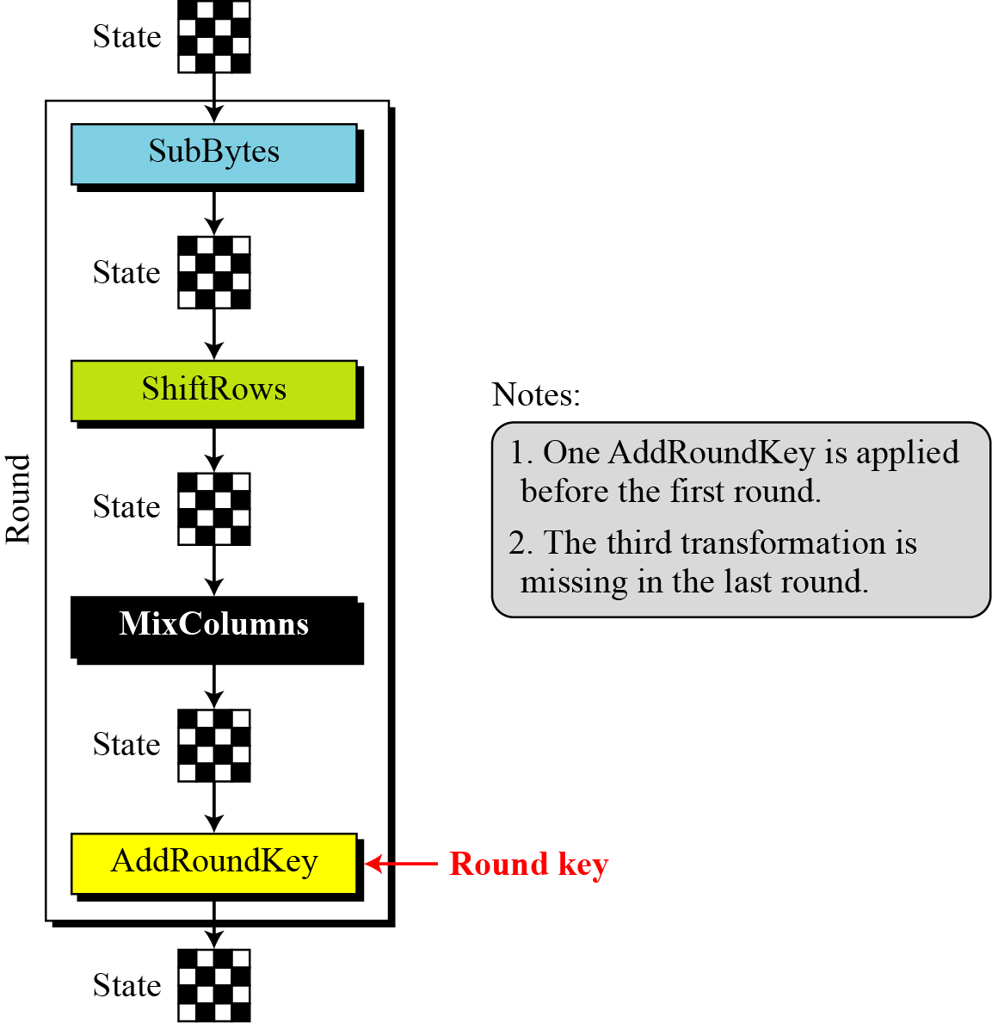
Details of each round

Slide 33
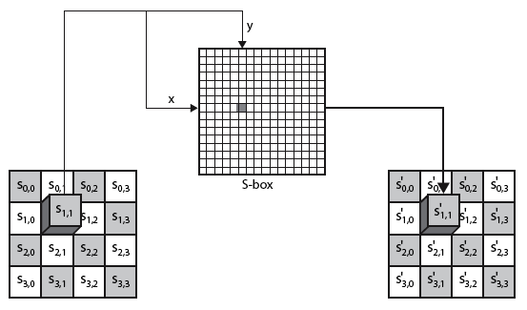
SubBytes Operation
The SubBytes operation involves 16 independent byte-to-byte substitutions.
Get S’_{1,1} from table
* Let S_{1,1} = xy
* Interpret a byte as two hexadecimal digits xy

Slide 34
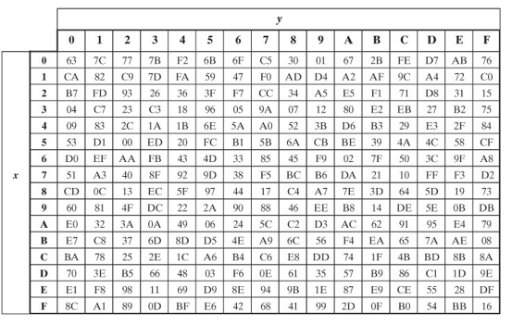
SubBytes Table
Implemented by table lookup

Slide 35
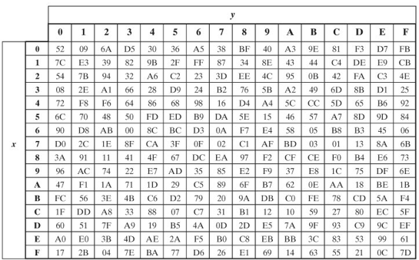
InvSubBytes Table

Slide 36
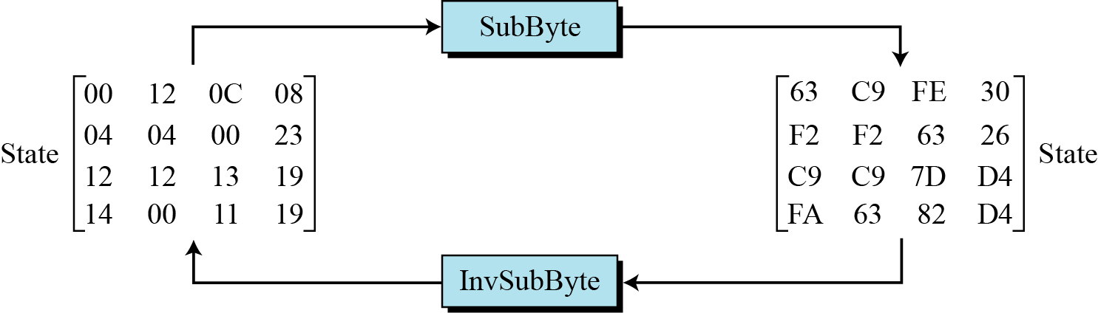
SubByte Example
The SubBytes and InvSubBytes transformations are inverses of each other.

Slide 37
ShiftRows
Shifting permutes the bytes.
Do a circular byte shift in each row
1st row is unchanged
2nd row does 1 byte circular shift to left
3rd row does 2 byte circular shift to left
4th row does 3 byte circular shift to left
In the encryption, the transformation is called ShiftRows
In the decryption, the transformation is called InvShiftRows and the shifting is to the right
Notes:
The ShiftRows stage provides a simple “permutation” of the data, whereas the other steps involve substitutions. Further, since the state is treated as a block of columns, it is this step which provides for diffusion of values between columns. It performs a circular rotate on each row of 0, 1, 2 & 3 places for respective rows. When decrypting it performs the circular shifts in the opposite direction for each row. This row shift moves an individual byte from one column to another, which is a linear distance of a multiple of 4 bytes, and ensures that the 4 bytes of one column are spread out to four different columns.

Slide 38
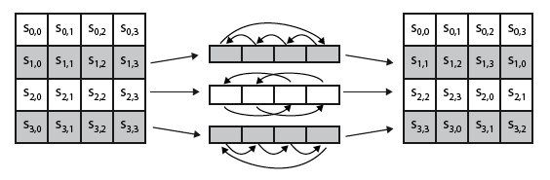
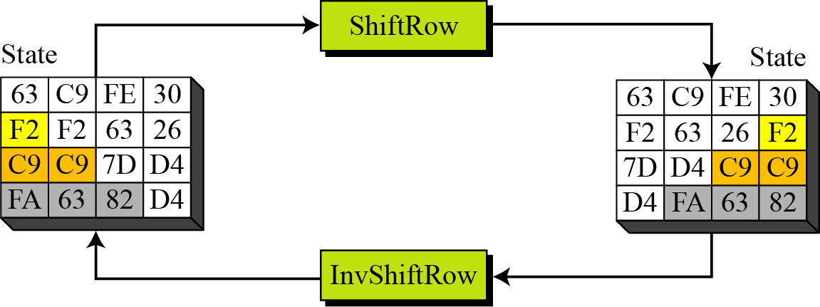
ShiftRows Scheme
Example
Notes:
Stalling Figure 5.5a illustrates the Shift Rows permutation.

Slide 39
MixColumns
ShiftRows and MixColumns provide diffusion to the cipher
In MixColumns, each column is processed separately
Each byte is replaced by a value dependent on all 4 bytes in the column
Effectively a matrix multiplication in finite field GF(2⁸) using prime polynomial x⁸+x⁴+x³+x+1
Notes:
The MixColumns stage is a substitution that makes use of arithmetic over GF(2^8). Each byte of a column is mapped into a new value that is a function of all four bytes in that column. It is designed as a matrix multiplication where each byte is treated as a polynomial in GF(2⁸). The inverse used for decryption involves a different set of constants.
The constants used are based on a linear code with maximal distance between code words – this gives good mixing of the bytes within each column. Combined with the “shift rows” step provides good avalanche, so that within a few rounds, all output bits depend on all input bits.

Slide 40
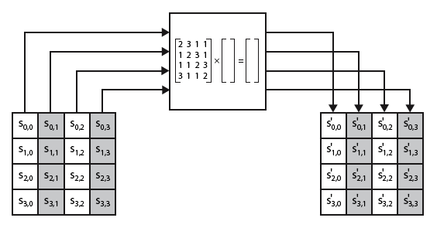
MixColumns Scheme
The MixColumns transformation operates at the column level; it transforms each column of the state to a new column.
Notes:
Stalling Figure 5.5b illustrates the Mix Columns transformation.
In practise, you implement Mix Columns by expressing the transformation on each column as 4 equations (Stallings equation 5.4) to compute the new bytes for that column. This computation only involves shifts, XORs & conditional XORs (for the modulo reduction).
The decryption computation requires the use of the inverse of the matrix, which has larger coefficients, and is thus potentially a little harder & slower to implement.
The designers & the AES standard provide an alternate characterisation of Mix Columns, which treats each column of State to be a four-term polynomial with coefficients in GF(2⁸). Each column is multiplied by a fixed polynomial a(x) given in Stallings eqn 5.7. Whilst this is useful for analysis of the stage, the matrix description is all that’s required for implementation.

Slide 41
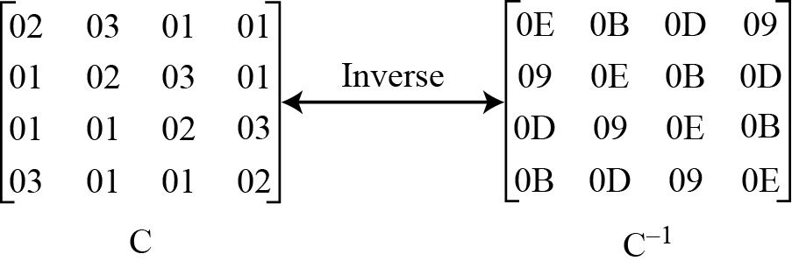
MixColumn and InvMixColumn
During decryption, inverse mixing matrix is used

Slide 42
AddRoundKey
XOR state with 128-bits of the round key
AddRoundKey proceeds one column at a time.
adds a round key word with each state column matrix
the operation is matrix addition
Inverse for decryption is identical
since XOR is its own inverse, with same keys
Notes:
Lastly is the Add Round Key stage which is a simple bitwise XOR of the current block with a portion of the expanded key. Note this is the only step which makes use of the key and obscures the result, hence MUST be used at start and end of each round, since otherwise could undo effect of other steps. But the other steps provide confusion/diffusion/non-linearity. That us you can look at the cipher as a series of XOR with key then scramble/permute block repeated. This is efficient and highly secure it is believed.

Slide 43
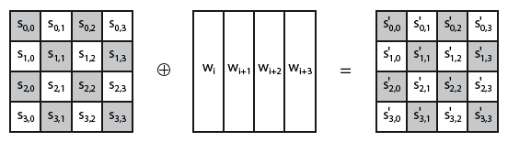
AddRoundKey Scheme
Notes:
Stallings Figure 5.4b illustrates the Add Round Key stage, which like Byte Substitution, operates on each byte of state independently.

Slide 44
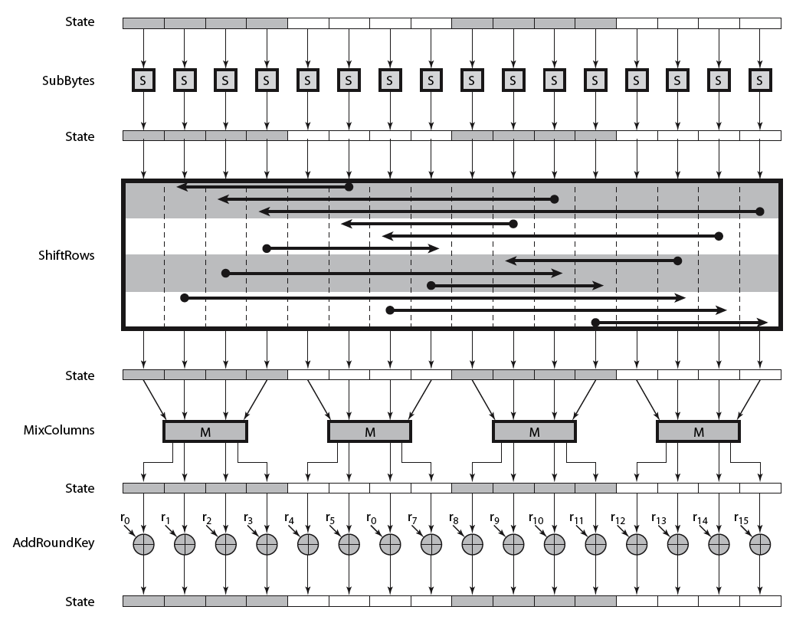
AES Round
Notes:
Can thus now view all the internal details of the AES round, showing how each byte of the state is manipulated, as shown in Stallings Figure 5.3.

Slide 45
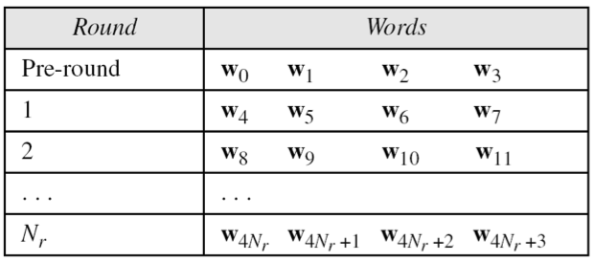
AES Key Scheduling (generating round keys)
takes 128-bits (16-bytes) key and expands into array of 44 words (32-bit each)
Notes:
The AES key expansion algorithm takes as input a 4-word (16-byte) key and produces a linear array of words, providing a 4-word round key for the initial AddRoundKey stage and each of the 10/12/14 rounds of the cipher. It involves copying the key into the first group of 4 words, and then constructing subsequent groups of 4 based on the values of the previous & 4th back words. The first word in each group of 4 gets “special treatment” with rotate + S-box + XOR constant on the previous word before XOR’ing the one from 4 back. In the 256-bit key/14 round version, there’s also an extra step on the middle word.

Slide 46
AES Security
AES was designed after DES.
Most of the known attacks on DES were already tested on AES.
Brute-Force Attack
AES is definitely more secure than DES due to the larger-size key.
Statistical Attacks
Numerous tests have failed to do statistical analysis of the ciphertext
Differential and Linear Attacks
There are no differential and linear attacks on AES as yet.

Slide 47
Implementation Aspects
The algorithms used in AES are so simple that they can be easily implemented using cheap processors and a minimum amount of memory.
Very efficient
Implementation was a key factor in its selection as the AES cipher
Several modern CPU architectures include AES instructions
https://en.wikipedia.org/wiki/AES_instruction_set
Notes:
AES can also be very efficiently implemented on an 32-bit processor, by rewriting the stage transformation to use 4 table lookups & 4 XOR’s per column of state. These tables can be computed in advance using the formulae shown in the text, and need 4Kb to store.
The developers of Rijndael believe that this compact, efficient implementation was probably one of the most important factors in the selection of Rijndael for AES.

Slide 48
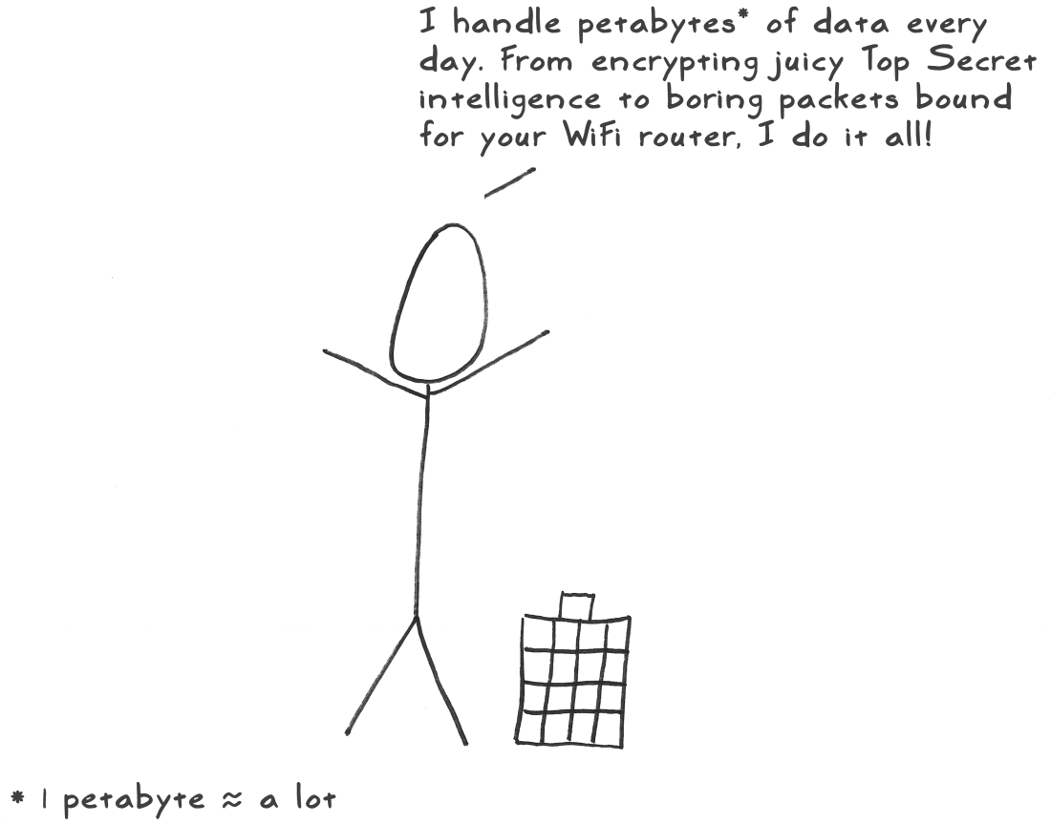
AES illustrated
A stick figure guide
http://www.moserware.com/2009/09/stick-figure-guide-to-advanced.html

Slide 49
Block Cipher Modes of Operation

Slide 50
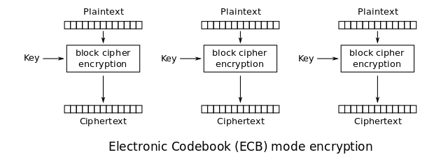
ECB mode
Block ciphers operate only on small fixed size chunks like 64 bits (DES), 128 bits (AES) etc.
To encrypt large data, one (lazy) option is to simply divide the whole data in blocks and encrypt them separately with same key. This is ECB mode.

Slide 51
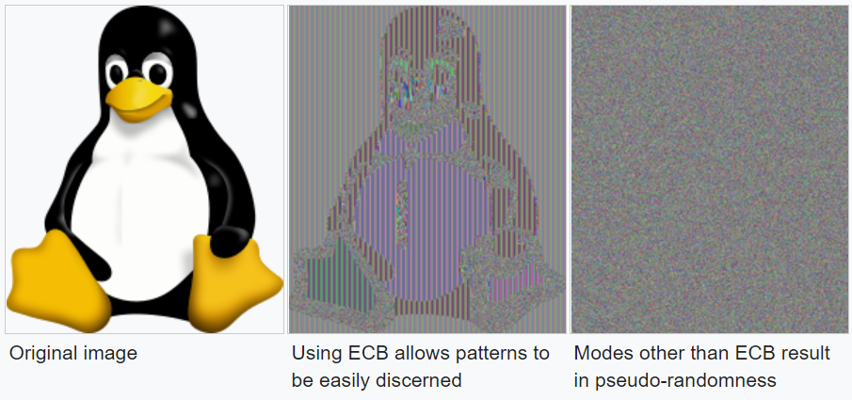
ECB mode: problem

Slide 52
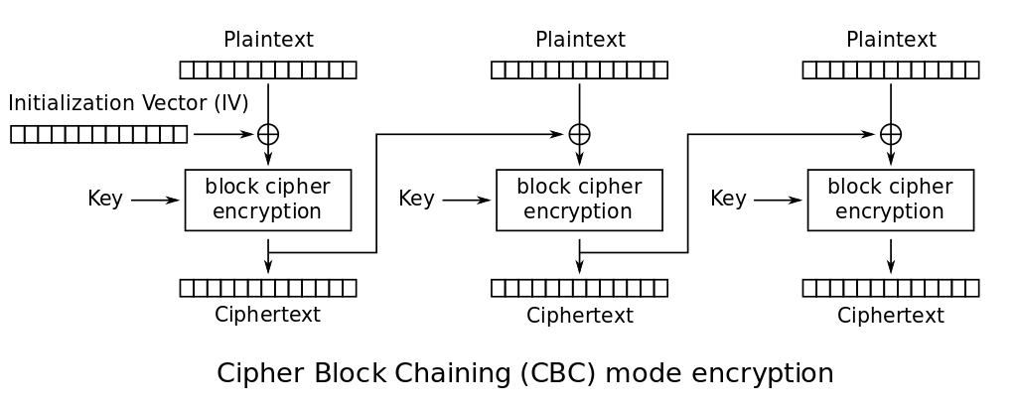
CBC mode
More secure modes are available, such as Cipher Block Chaining (CBC)
Each ciphertext block depends on all plaintext blocks processed up to that point
Any fixed (non-secret) value to start with

Slide 53
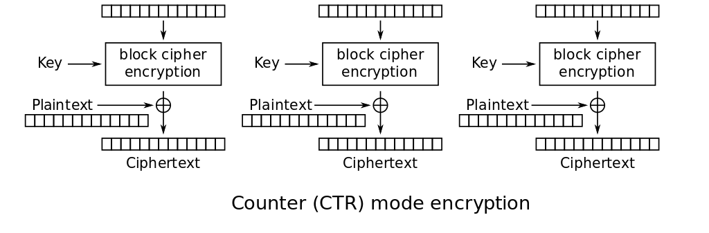
CTR mode
Another one is Counter mode
Start with any pre-defined counter value and then keep incrementing.
Can encrypt blocks in parallel (unlike CBC mode)
Counter
Counter + 1
Counter + (N – 1)

